Slide 1
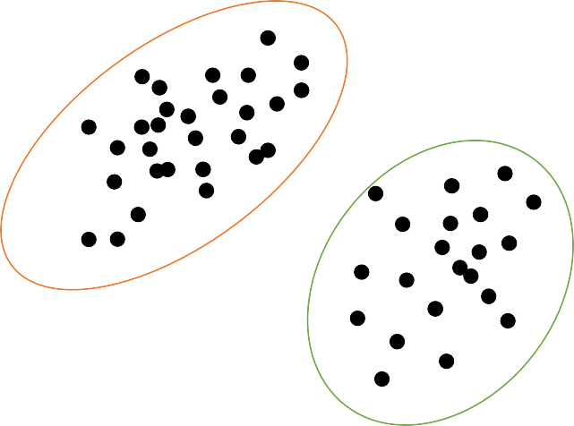
What is Clustering?
Clustering is the task of grouping the data points into set of objects
Data points that are in the same group should exhibit similar features, while data points in different groups exhibit dissimilar properties and features.
Unsupervised learning and is a common technique for statistical data analysis used in many fields.

Slide 2
What is Clustering?
Student ID | Gender | Major | Grade
SD-001 | M | Math | A+
SD-002 | M | Math | A
SD-003 | F | Statistics | A+
SD-004 | F | Math | A
SD-005 | F | Math | B
SD-006 | M | Statistics | B
SD-007 | F | Physics | A+
SD-008 | F | Physics | A
SD-009 | M | Statistics | B+
SD-010 | F | Math | B+
SD-001 SD-002 SD-004 SD-005 SD-010
SD-003 SD-006 SD-009
Cluster of Major
SD-007 SD-008

Slide 3
What is Clustering?
Student ID | Gender | Major | Grade
SD-001 | M | Math | A+
SD-002 | M | Math | A
SD-003 | F | Statistics | A+
SD-004 | F | Math | A
SD-005 | F | Math | B
SD-006 | M | Statistics | B
SD-007 | F | Physics | A+
SD-008 | F | Physics | A
SD-009 | M | Statistics | B+
SD-010 | F | Math | B+
SD-003 SD-004 SD-005 SD-007 SD-008 SD-010
SD-001 SD-002 SD-006 SD-009
Gender Specific Clusters

Slide 4
What is Clustering?
Student ID | Gender | Major | Grade
SD-001 | M | Math | A+
SD-002 | M | Math | A
SD-003 | F | Statistics | A+
SD-004 | F | Math | A
SD-005 | F | Math | B
SD-006 | M | Statistics | B
SD-007 | F | Physics | A+
SD-008 | F | Physics | A
SD-009 | M | Statistics | B+
SD-010 | F | Math | B+
SD-001 SD-003 SD-007
SD-002 SD-004 SD-008
Grade Clusters
SD-005 SD-006
SD-009 SD-010

Slide 5
Examples of Clustering
Recommendation engines
Market segmentation
Social network analysis
Medical/Health
Image segmentation
Anomaly detection

Slide 6
How Clustering works?

Slide 7
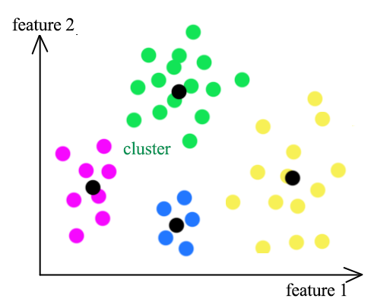
Centroid Based Clustering
These Models work on the notion that similarity is derived by the closeness of a data point to the centroid of the clusters.
The Points will be divided into different Clusters based on the Closeness to a Centroid.
One of the Most Famous algorithms that fall under this category is K Means Algorithm.

Slide 8



How Clusters are formed?

Slide 9


























How Clusters are formed?
Iteration - 1

Slide 10




How Clusters are formed?
Iteration - 2

Slide 11


How Clusters are formed?
Iteration - 3

Slide 12






How Clusters are formed?
Iteration - 4

Slide 13




How Clusters are formed?
Iteration - 5

Slide 14
How Clusters are formed?
Similar characteristics
Proportionate number of observations

Slide 15


















Good Cluster Analysis
Observations in the same group share similar characteristics
Clusters have proportionate number observations

Slide 16
How to Decide Number of Clusters?

Slide 17
Elbow Method
The elbow method is a heuristic used in determining the number of optimum clusters in a data set.
This Method Helps us to find out the Optimum Number of Clusters in a Data set.
We plot the explained variation against the number of clusters and finally pick the elbow of the curve as the number of clusters to use.

Slide 18
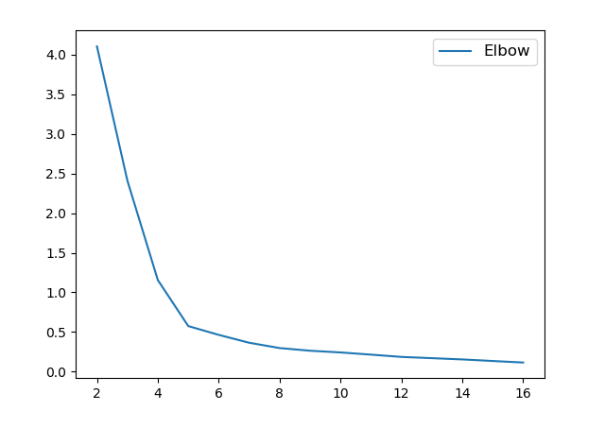




Drop in inertia
Inertia
Drop in inertia
Drop in inertia
Elbow
Number of Clusters

Slide 19
K Means Clustering
K Means algorithm is a Centroid Based Algorithm.
It tries to make the intra-cluster data points as similar as possible while also keeping the clusters as different as possible.
It assigns data points to a cluster such that the sum of the squared distance between the data points and the cluster’s centroid minimum.
The less variation we have within clusters, the more homogeneous the data points are within the same cluster.

